Slide 1
BTP Presentation
Himanshu
18ME10024

Slide 2
Introduction
Dsdas
Sadasdas
Dasdas
Das
d

Slide 3
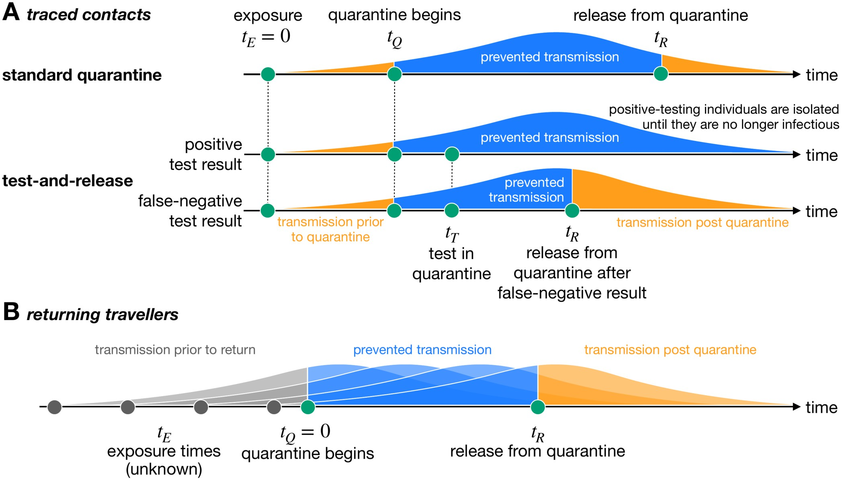
Motivation and Existing Solution
Several Public health agencies and Researchers have pointed out that "Increased rate of Testing has led to significant prevention in transmission“
Testing plays a very vital role in

Slide 4
Problem Statement

